Slide 1
RL Reliability
By Manthan Patel

Slide 2
Ref
Measuring the Reliability of Reinforcement Learning Algorithms (https://arxiv.org/abs/1912.05663)

Slide 3
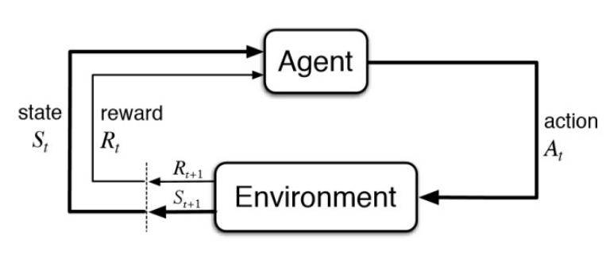
Reinforcement Learning(RL)
Reinforcement Learning(RL) is a type of machine learning technique that enables an agent to learn in an interactive environment by trial and error using feedback from its own actions and experiences.
both supervised and reinforcement learning use mapping between input and output,
supervised learning where feedback provided to the agent is correct set of actions for performing a task,
reinforcement learning uses rewards and punishment as signals for positive and negative behavior.

Slide 4
Reinforcement Learning(RL)
the goal in unsupervised learning is to find similarities and differences between data points,
In reinforcement learning the goal is to find a suitable action model that would maximize the total cumulative reward of the agent.

Slide 5
Elements of a RL problem
Environment: Physical world in which the agent operates
State: Current situation of the agent
Reward: Feedback from the environment
Policy: Method to map agent’s state to actions
Value: Future reward that an agent would receive by taking an action in a particular state

Slide 6
Markov Decision Processes (MDPs) are mathematical frameworks to describe an environment in reinforcement learning and almost all RL problems can be formalized using MDPs.
An MDP consists of:
a set of finite environment states S,
a set of possible actions A(s) in each state,
a real valued reward function R(s) and a transition model P(s’, s | a).
However, real world environments are more likely to lack any prior knowledge of environment dynamics. Model-free RL methods come handy in such cases.

Slide 7
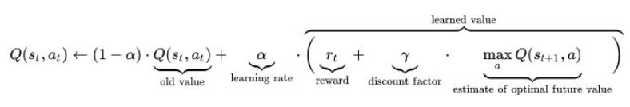
Model-free RL
Q-learning is a commonly used model free approach.
It revolves around the notion of updating Q values which denotes value of doing action a in state s.
The value update rule is the core of the Q-learning algorithm.

Slide 8
Reproducibility Problem in Reinforcement Learning
[Robotics Case Study: https://arxiv.org/pdf/1909.03772.pdf]

Slide 9
Problems
Common issues when replicating ML research:
Omission of one or more hyperparameter choices in the manuscript.:
Often hyper-parameters have significant impacts on how the algorithm performs so it is critical to report their values including how they were obtained.
Reason for neglecting to report hyper-parameters: a) they are not considered important or b) their value is simply the default value, specified by the underlying implementation used.
Both reasons are obviously important challenges to handle but are often hard to discover and subsequently enforce.

Slide 10
Problems
RL methods require large amounts of data:
Results from the real world are thus expensive to obtain.
Further, many industrial researchers are forced by their company’s legal department to omit specific details to remain in front of their competitors

Slide 11
Problems
differences in evaluation metrics
lack of significance testing in the field of DRL
Effects:
misleading reporting of results
With no statistical evaluation of the results, it is difficult to conclude if there are meaningful improvements.
If results are to be trusted, complete and statistically correct evaluations of proposed methods are needed.

Slide 12
Requirements
reliability metrics
practical recommendations for statistical tests to compare metric results

Slide 13
RELIABILITY METRICS: AXES OF VARIABILITY
During training: Across Time (T)
In the setting of evaluation during training, one desirable property for an RL algorithm is to be stable "across time" within each training run.
In general, smooth monotonic improvement is preferable to noisy fluctuations around a positive trend, or unpredictable swings in performance.
2. During training: Across Runs (R)
During training, RL algorithms should have easily and consistently reproducible performances across multiple training runs.

Slide 14
AXES OF VARIABILITY
3. After learning: Across rollouts of a fixed policy (F)
When evaluating a fixed policy, a natural concern is the variability in performance across multiple rollouts of that fixed policy.
Each rollout may be specified e.g. in terms of a number of actions, environment steps, or episodes.

Slide 15
MEASURES OF VARIABILITY
Two kinds of measures: dispersion and risk.
[Dispersion: width of the distribution.]
To measure dispersion:
Inter-quartile range (IQR) (i.e. the difference between the 75th and 25th percentiles)
Median absolute deviation (MAD).
prefer to use IQR over MAD, because it is more appropriate for asymmetric distributions

Slide 16
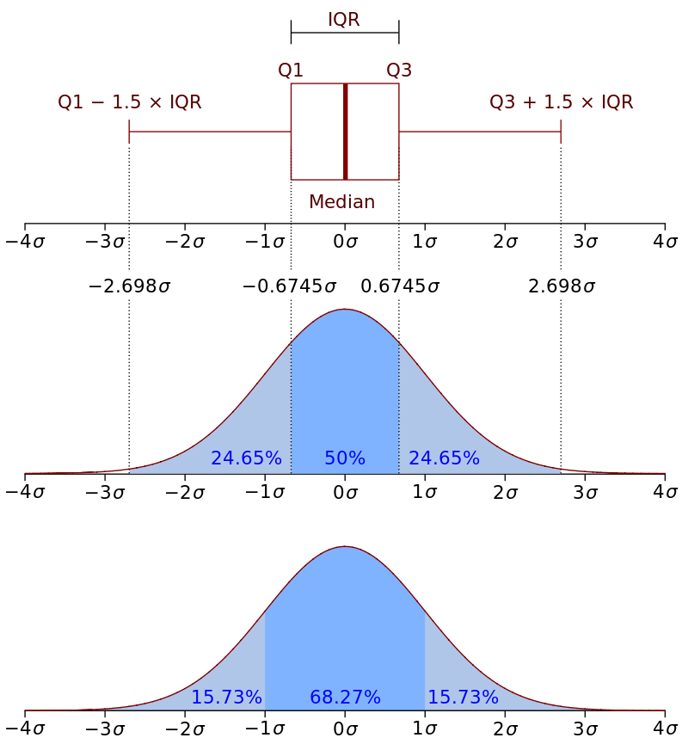
Quartile and IQR
In statistics, a quartile is a type of quantile which divides the number of data points into four parts, or quarters, of more-or-less equal size. The data must be ordered from smallest to largest to compute quartiles; as such, quartiles are a form of order statistic. The three main quartiles are as follows:
The first quartile (Q₁) is defined as the middle number between the smallest number (minimum) and the median of the data set. It is also known as the lower or 25th empirical quartile, as 25% of the data is below this point.
The second quartile (Q₂) is the median of a data set; thus 50% of the data lies below this point.
The third quartile (Q₃) is the middle value between the median and the highest value (maximum) of the data set. It is known as the upper or 75th empirical quartile, as 75% of the data lies below this point.

Slide 17
Median absolute deviation
[Univariate is a term commonly used in statistics to describe a type of data which consists of observations on only a single characteristic or attribute.]
Example:
Consider the data (1, 1, 2, 2, 4, 6, 9). It has a median value of 2. The absolute deviations about 2 are (1, 1, 0, 0, 2, 4, 7) which in turn have a median value of 1 (because the sorted absolute deviations are (0, 0, 1, 1, 2, 4, 7)). So the median absolute deviation for this data is 1.

Slide 18
Risk
In many cases, we are concerned about the worst-case scenarios.
Therefore, we define risk as the heaviness and extent of the lower tail of the distribution.
This is complementary to measures of dispersion like IQR, which cuts off the tails of the distribution.
To measure risk, we use the Conditional Value at Risk (CVaR), also known as “expected shortfall".

Slide 19
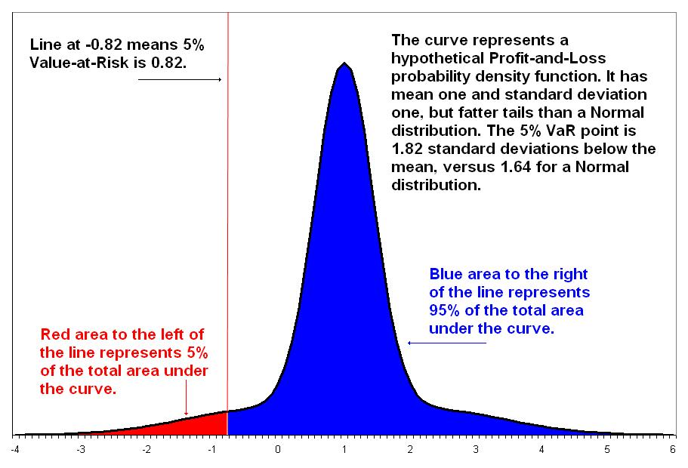
Conditional Value at Risk (CVaR)
CVaR measures the expected loss in the worst-case scenarios, defined by some quantile α.
It is computed as the expected value in the left-most tail of a distribution
definition for the CVaR of a random variable X for a given quantile α:
where α ∈ (0, 1) and the VaR_α (Value at Risk Cut Off) is just the α-quantile of the distribution of X.
Originally developed in finance, CVaR has also seen recent adoption in Safe RL as an additional component of the objective function.

Slide 20
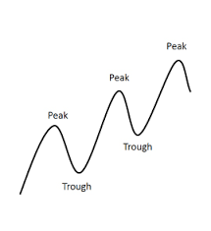
METRIC DEFINITIONS
Dispersion across Time (DT): IQR across Time
isolate higher-frequency variability, rather than capturing longer-term trends
Short-term Risk across Time (SRT): CVaR on Differences
measure the most extreme short-term drop over time
Long-term Risk across Time (LRT): CVaR on Drawdown
able to capture whether an algorithm has the potential to lose a lot of performance relative to its peak, even if on a longer timescale, e.g. over an accumulation of small drops.
[A maximum drawdown (MDD) is the maximum loss from a peak to a trough of a portfolio]

Slide 21
METRIC DEFINITIONS
Dispersion across Runs (DR): IQR across Runs
Risk across Runs (RR): CVaR across Runs
Dispersion across Fixed-Policy Rollouts (DF): IQR across Rollouts
Risk across Fixed-Policy Rollouts (RF): CVaR across Rollouts

Slide 22
Basic Criteria
A minimal number of configuration parameters – to facilitate standardization
Robust statistics, when possible. Robust statistics are less sensitive to outliers and have more reliable performance for a wider range of distributions.
Invariance to sampling frequency – results should not be biased by the frequency at which an algorithm was evaluated during training
Enable meaningful statistical comparisons on the metrics, while making minimal assumptions about the distribution of the results.

Slide 23
Code Ref
https://github.com/google-research/rl-reliability-metrics
[The RL Reliability Metrics library provides a set of metrics for measuring the reliability of reinforcement learning (RL) algorithms. The library also provides statistical tools for computing confidence intervals and for comparing algorithms on these metrics.
As input, this library accepts a set of RL training curves, or a set of rollouts of an already trained RL algorithm. The library computes reliability metrics across different dimensions (additionally, it can also analyze non-reliability metrics like median performance), and outputs plots presenting the reliability metrics for each algorithm, aggregated across tasks or on a per-task basis. The library also provides statistical tests for comparing algorithms based on these metrics, and provides bootstrapped confidence intervals of the metric values.]

Slide 24
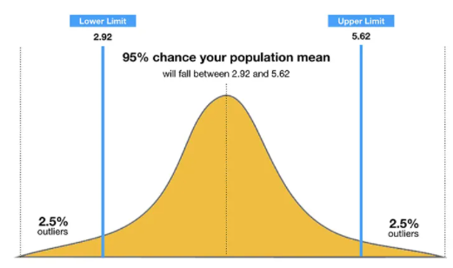
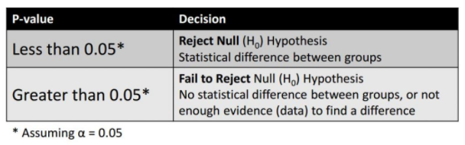
CONFIDENCE INTERVALS AND STATISTICAL SIGNIFICANCE TESTS FOR COMPARISON
A confidence interval displays the probability that a parameter will fall between a pair of values around the mean.
Compare algorithms evaluated on a fixed set of environments.
To determine whether any two algorithms have statistically significant differences in their metric rankings, we perform an exact permutation test on each pair of algorithms.
Such tests allow us to compute a p-value for the null hypothesis (probability that the methods are in fact indistinguishable on the reliability metric).
that runs are exchangeable across the two algorithms being compared.

